Slide 1
Version Control
Learning the basics with
Github and SourceTree

Slide 2
Getting Started
Go make a Github account (or bitbucket)
https://github.com/
and go get source tree
http://www.sourcetreeapp.com/

Slide 3
Git, Github,SourceTree? What’s the difference???
Git
Software as old as Unix that parses files compares them, finds the differences.
More importantly allows you to merge different versions of same file, keep track of older versions and a whole bunch of super useful stuff
SourceTree
It’s a Git interface for people who don’t like command-line
lots of pretty pics and UI
Github
Online host for your repositories so it is easy to share them with your coworkers and easy to contribute to other people’s projects

Slide 4
Setting up a Repo
Create Repo
Add Contributors
Cloning a new repo
you’re just grabbing a repository that exists elsewhere and putting it on your machine
Go into sourceTree, hit clone/new in the top right corner

Slide 5
Pushing
Before you’re ready to push you need to commit your changes
First stage all file changes you want to commit
please remember to save everything before pushing
save your scene and your project in unity
removing vs discarding changes

Slide 6
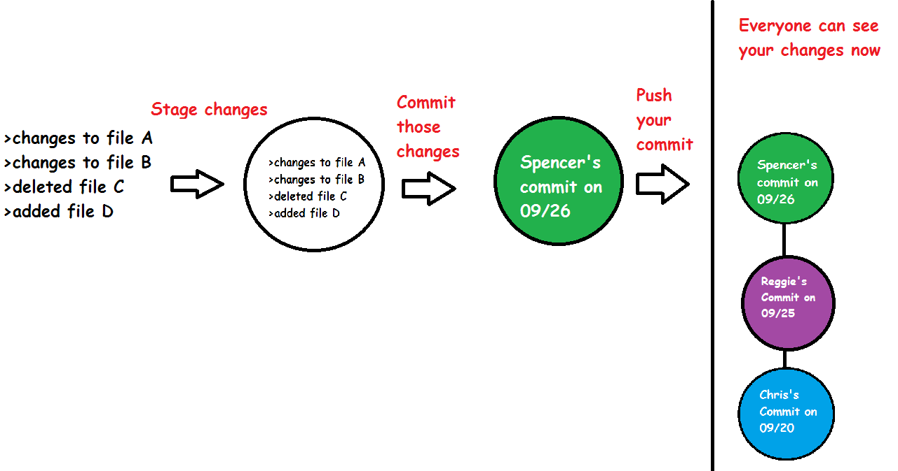
Pushing
Before you’re ready to push you need to commit your changes
First stage all file changes you want to commit
removing vs discarding changes

Slide 7
Merge Conflicts
resolve with theirs
resolve with mine
mark resolved
reset current branch to commit

Slide 8
Pushing your changes- workflow
Check to make sure it still works on your end
|
V
stage changes - commit - fetch - pull - merge - ( ͡° ͜ʖ ͡°) - commit - push

Slide 9
Git with Unity
They get along for the most part
go to Edit ->Project Settings->Editor
Set Asset Serialization to “Forced Text”
Set Version Control Mode “Visible Meta Files”
Don’t work on the same scene at the same time (I think this actually isn’t really a big deal in 5.0 and up)
Avoid changing the same scripts at the same time
if you do, try not to edit the same lines or parts of code

